Slide 1
Ctrl-Alt-Elite
Members: Dhruv Mehta, Kavya Kurup, Sydney Medina, Juhi Patel, Pritom Das Radheshyam

Slide 2
Overview
Introduction
Motivation
Approach
Preparation
Artifact extraction
Classification Methods

Slide 3
Introduction
What is Cyber-attack attribution using malware artifacts?
•Cyber-attack attribution using malware artifacts is the process of attempting to trace back a piece of code or malware to a perpetrator of a cyberattack
What is our groups focus?
•Using Machine Learning to attribute malware samples to a country using PE Header files and other artifacts gathered from VirusTotal

Slide 4
Motivation
•Increase in cyber attacks
•We have become more dependent on technology
•Can help combat malware development by identifying authorship
•Our focus: Identifying state-sponsored malware

Slide 5
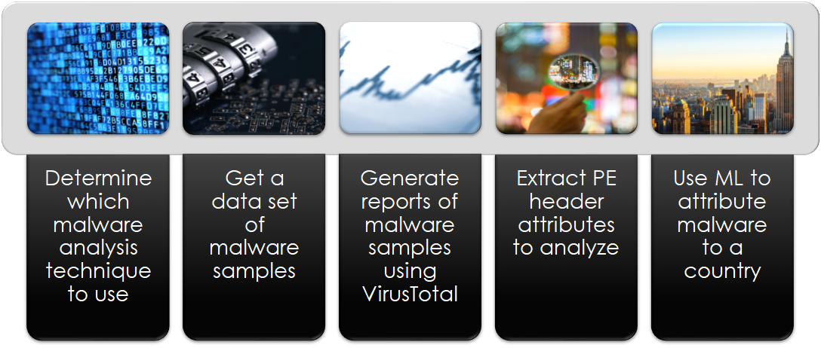
Approach

Slide 6
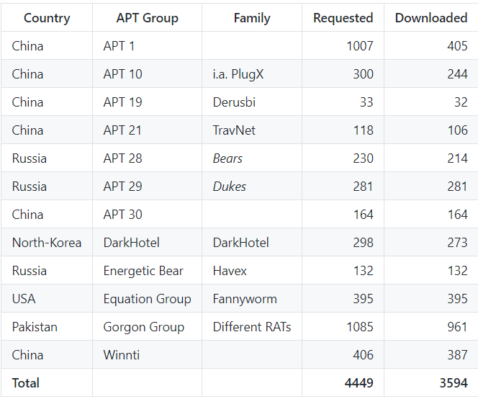
Preparation
Set up environment to work with malware safely
  UTD sponsored virtual machine preloaded with Windows 7
  Host access/GUI access
  Revertible
Obtain Dataset
  Github repository containing about 3,600 state-sponsored malware samples
  Windows Portable Executables
  Generate VirusTotal reports for all of the malware

Slide 7
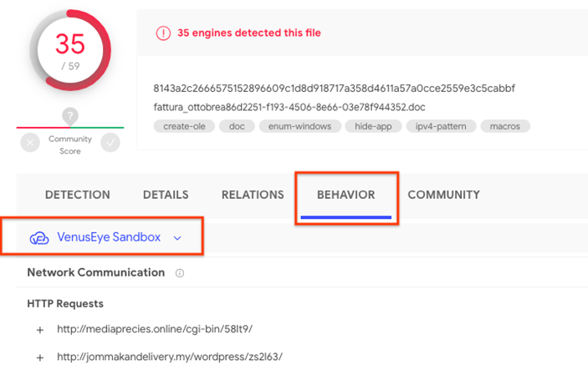
VirusTotal Reports
Created a script that extracts data from the VirusTotal API
  Only allowed 4 calls per minute, took about 14 hours to gather all of the reports
VirusTotal shows the runtime behavior of the samples which will supplement our artifact list

Slide 8
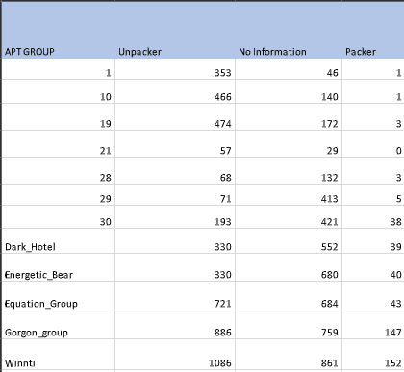
Preparation
Clean dataset
  Separate packed from unpacked malware samples using PEiD tool
    Packers obfuscate data, so we would have to unpack the malware to extract artifacts
  Separate and discard the malware that we were unable to generate VirusTotal reports for
  Choose one APT group per country
  Left with over 1,500 malware samples to extract artifacts from

Slide 9
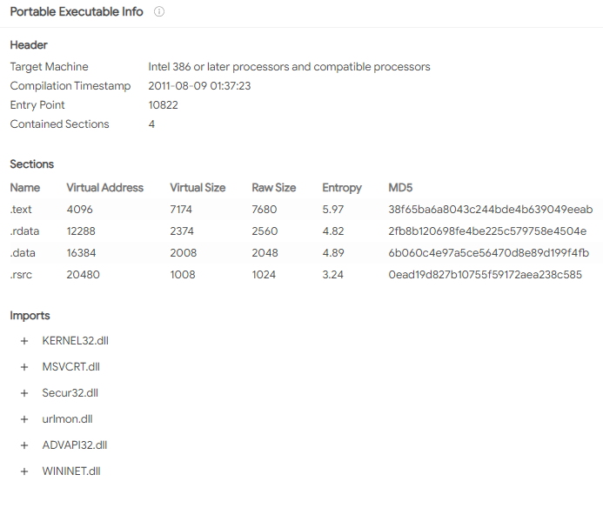
Artifact Extraction
Parse through VirusTotal report files
  Files opened by malware
  Services opened by malware
  Runtime modules
  Imports
  Sections
PE Header
  PEStudio tool
  Target machine
  Compilation Timestamp

Slide 10
Detecting attribution through Data Science
Incorporating the right Machine Learning and Deep Learning classifiers for attribution
Extensive usage of open sourced python libraries like: scikit learn, numpy, seaborn, pandas, tensorflow, keras, pefile, ludwig
Researching the following possible classifiers:
    Random Forest
    K Nearest Neighbour
    Deep Learning

Slide 11
References
[1] Boot, Coen. Applying Supervised Learning on Malware Authorship Attribution. Diss. Radboud University Nijmegen, 2019.
[2] Aylin Caliskan, Fabian Yamaguchi, Edwin Dauber, Richard Harang, Konrad Rieck, Rachel Greenstadt, Arvind Narayanan “When Coding Style Survives Compilation: De-Anonymizing Programmers from Executable Binaries.” N.p., 2015. Web.
https://arxiv.org/abs/1512.08546
[3] Ferhat Ozgur Catak​, Ahmet Faruk Yazı,Ogerta Elezaj, Javed Ahmed “Deep Learning Based Sequential Model for Malware Analysis Using Windows Exe API Calls.” PeerJ. Computer science 6 (2020): e285–. Web.
https://peerj.com/articles/cs-285/
[4] Haddadpajouh, Hamed ; Azmoodeh, Amin ; Dehghantanha, Ali ; Parizi, Reza M. “MVFCC: A Multi-View Fuzzy Consensus Clustering Model for Malware Threat Attribution.” IEEE access 8 (2020): 139188–139198. Web.
[5] Kaspersky, Eugene, et al. “The Power of Threat Attribution-Kaspersky Threat Attribution Engine” https://media.kaspersky.com/en/business-security/enterprise/threat-attribution-engine-whitepaper.pdf
[6] Rosenberg, Ishai ; Sicard, Guillaume ; David, Eli “DeepAPT: Nation-State APT Attribution Using End-to-End Deep Neural Networks.” Artificial Neural Networks and Machine Learning – ICANN 2017 Lecture Notes in Computer Science, 2017, pp. 91–99., doi:10.1007/978-3-319-68612-7_11.

